Slide 1
Prototype 1
CS 643 Team2

Slide 2
Prototype 1= Prototype 0 + Changes

Slide 3
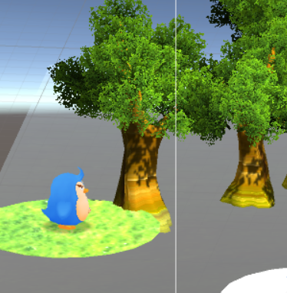
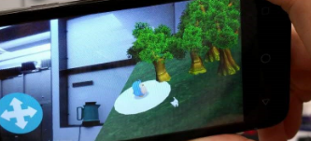
Changes:
Make the ground 90% transparent
Size of the object

Slide 4
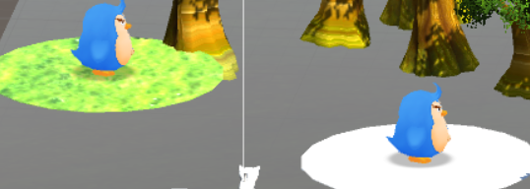
Changes: add functions
Added touch scale function
Added penguin

Slide 5
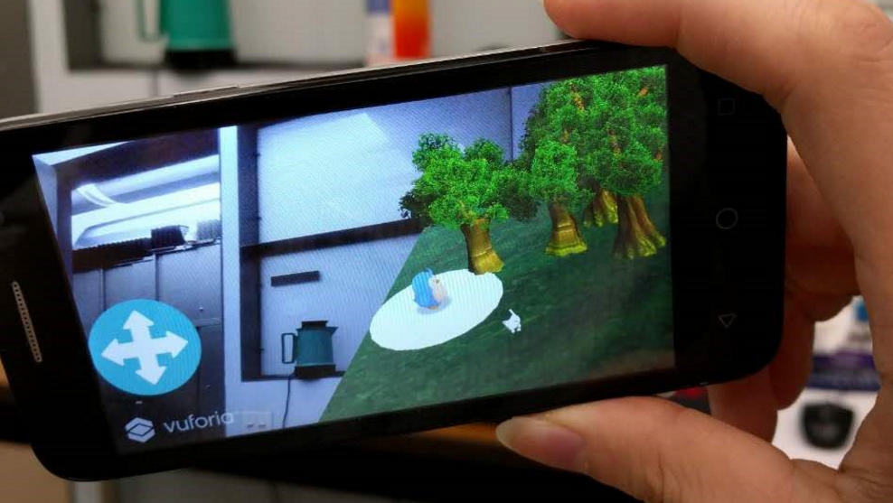
Changes: remove redundants
Remove Trees
Remove extra lighting source

